Slide 1



Smart Vending Shelf With Contactless Payment System
CS17IUH
Sep 12th, 2025
© Copyright FPT Software – Level of Confidentiality
1
Notes:
1

Slide 2

CONTENT
01
Objective and System overview
03
System Design and Development
02
System diagram
04
Risk Management
04
© Copyright FPT Software – Confidential
2
Notes:
2

Slide 3
01
Objective
© Copyright FPT Software – Confidential
3
Notes:
3

Slide 4
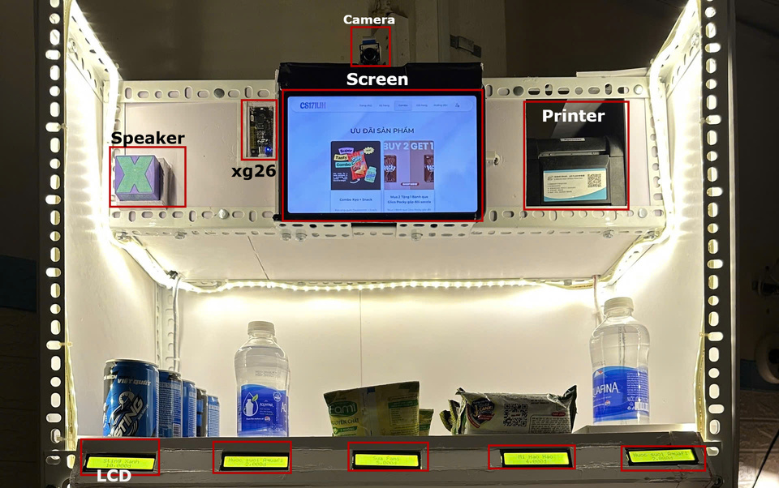
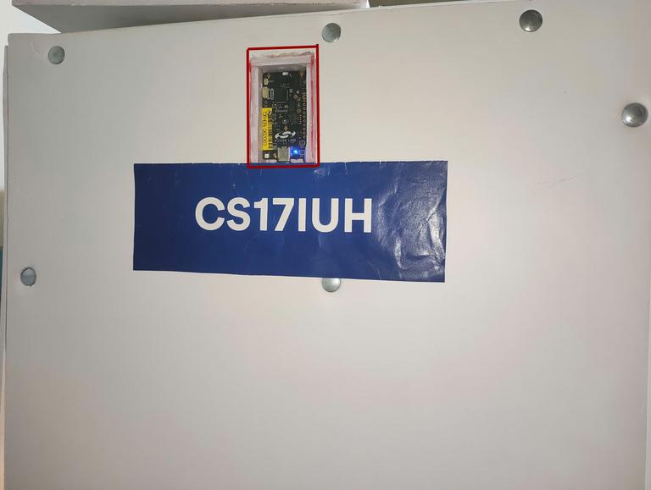
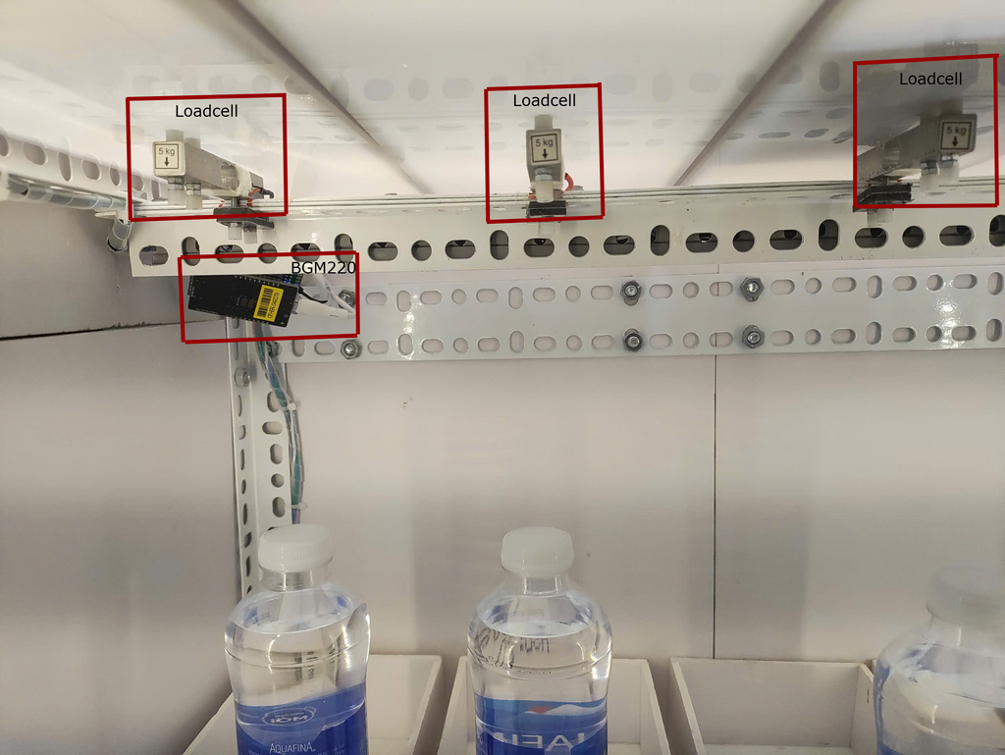
Objective and System overview
Automatically monitors and updates the quantity of snack items on each shelf using BLE - Loadcells.
Displays real-time purchase information (item type, quantity, unit price, and total price) on a payment screen.
Supports quick and contactless payments with VietQR and SEPAY API integration.
Detects and alerts when a customer attempts to leave without payment using a surveillance camera system.
Notifies staff when the inventory level of any item falls below a predefined threshold.
Voice command integration via XG26 sensor for enhanced accessibility and user interaction (payment, products, combo, discounts)
Trigger an alert if the shelf is shaken, tilted or if the product is placed in the wrong position.
Management web interface to control product and shelf information.
© Copyright FPT Software – Confidential
4
Notes:
The objective of this project is to develop a snack shelf that integrates load cell sensors, image processing (camera), and electronic payment.
Automatically monitors and updates the quantity of snack items on each shelf using weight sensors.
Displays real-time purchase information (item type, quantity, unit price, and total price) on a payment screen.
Supports quick and contactless payments via QR code.
Detects and alerts when a customer attempts to leave without payment using a surveillance camera system.
Notifies staff when the inventory level of any item falls below a predefined threshold. Easy configuration of product details, pricing, and thresholds via mobile/web interface.
Real-world Application Context
Unmanned mini-stores or convenience kiosks
Office buildings, schools, hospitals, or apartment complexes
Facilitates remote inventory monitoring and low-cost sales operations.
Small businesses testing self-service retail

Slide 5
02
System diagram
© Copyright FPT Software – Confidential
9
Notes:
9

Slide 6
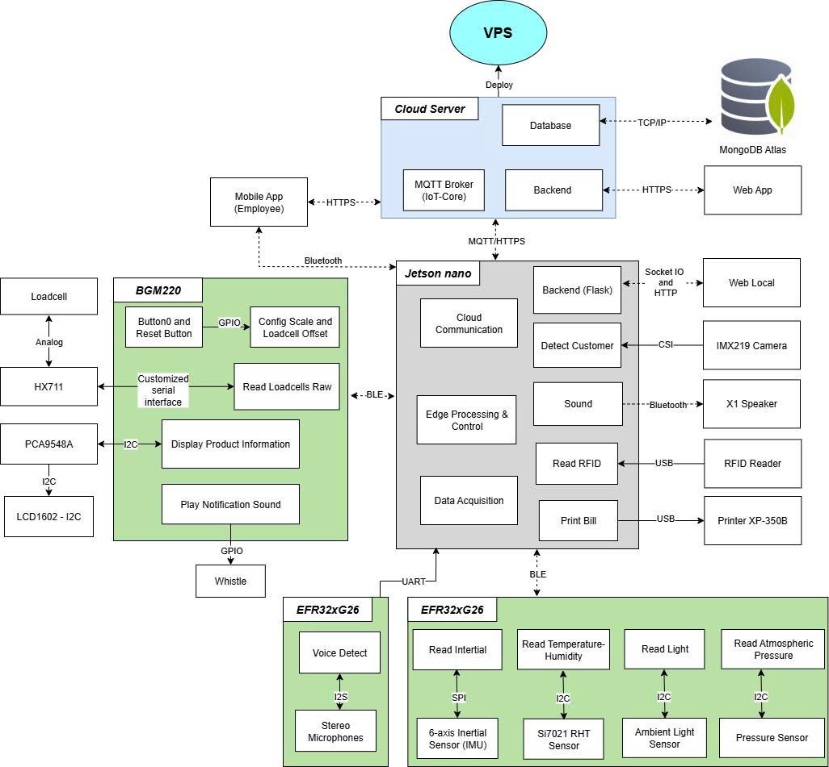

System Diagram
© Copyright FPT Software – Confidential
10
Notes:
10

Slide 7
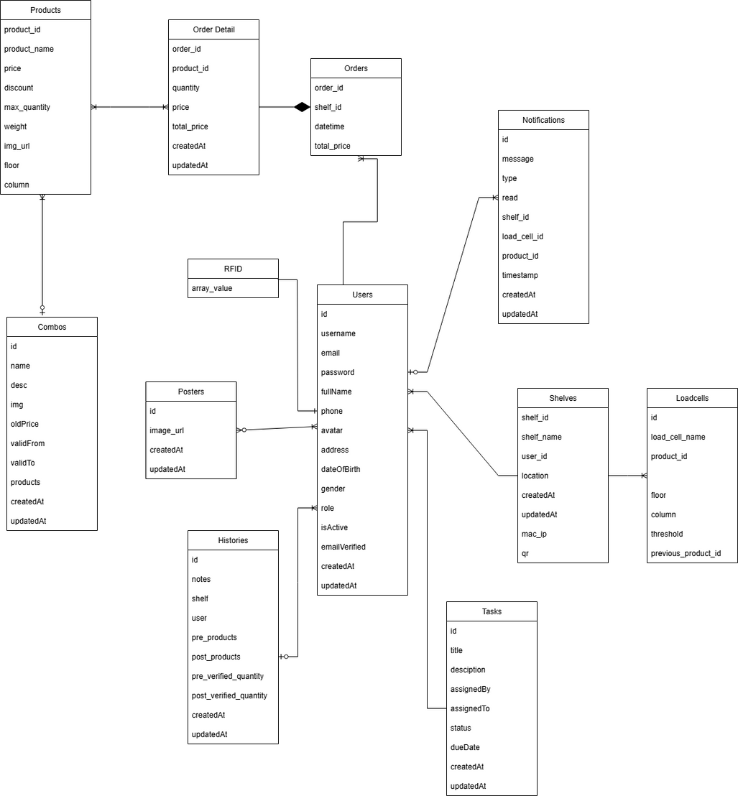
Class Diagram
© Copyright FPT Software – Confidential
10
Notes:
10

Slide 8
03
System Design and Development
© Copyright FPT Software – Confidential
11
Notes:
11

Slide 9
System Design
WebSocket Server (Flask-SocketIO): Handles >80% real-time interactions like cart updates, payment tracking, device sync, voice/RFID commands, error detection.
Uses multi-threading for QR/payment monitoring; broadcast emit delivers real-time data to all clients.
In terms of hardware, data from the Loadcell is transmitted via BLE, while voice input is captured by the XG26 kit and sent to WebSocket.
For the payment workflow, VietQR and SEPAY services are integrated to generate QR codes and continuously monitor transactions.
To maintain robustness, the system implements strict session management, data validation, and error handling mechanisms, ensuring both security and reliability throughout the workflow.
© Copyright FPT Software – Confidential
7
Notes:
7

Slide 10

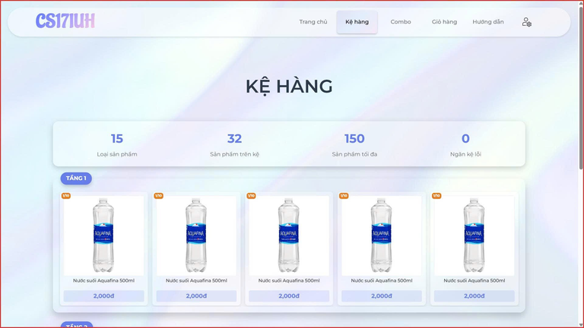
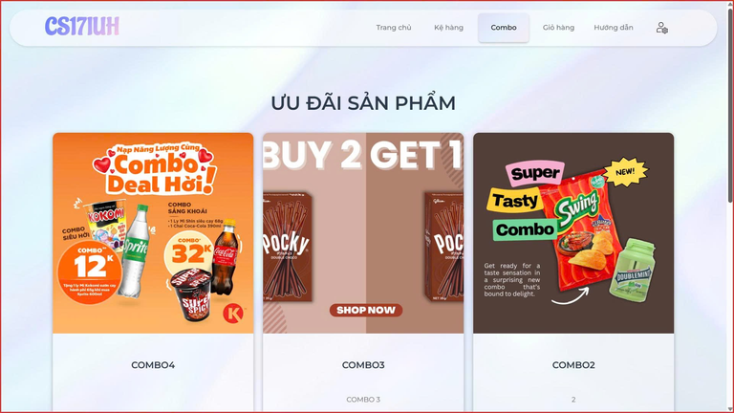
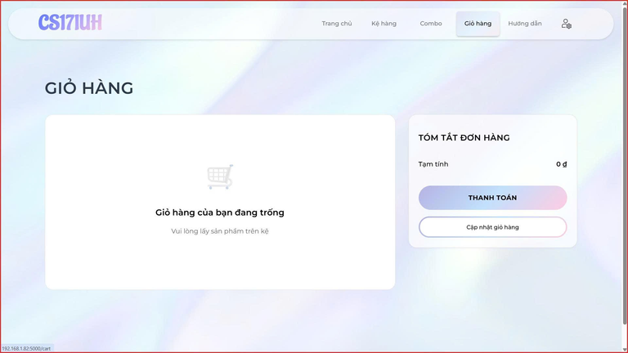
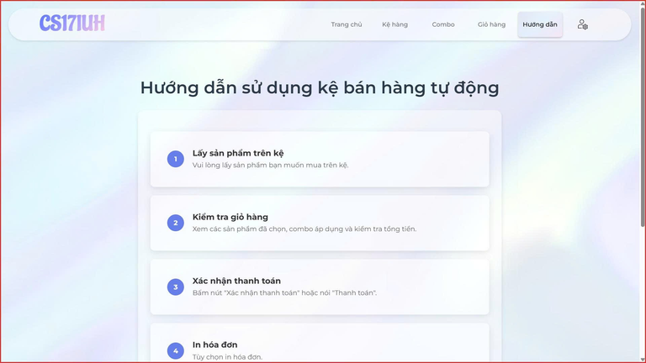
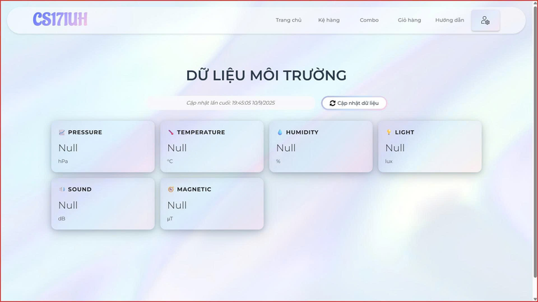
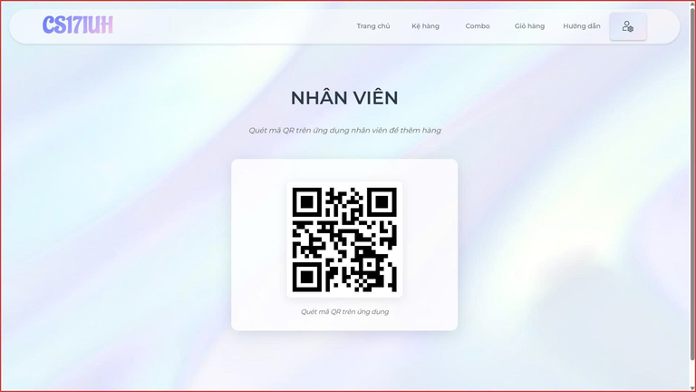
System Design
© Copyright FPT Software – Confidential
7
Notes:
7

Slide 11
System Design
This system integrates Node.js (backend) and React (frontend) to provide smart shelf and inventory management. Real-time data from Jetson sensors is transmitted via MQTT for stock monitoring, replenishment suggestions, and automatic alerts on discrepancies. Managers can easily optimize warehouse operations and track sales performance.
With React, the frontend ensures smooth, real-time updates, while ExpressJS on Node.js powers the backend with RESTful APIs, high performance, and easy integration with databases and middleware. The Web API architecture enables scalability, ERP/WMS integration, and future mobile app expansion.
The system adopts a modern Web API model, serving as the central communication layer between IoT devices, the database, and the user interface.
© Copyright FPT Software – Confidential
7
Notes:
7

Slide 12
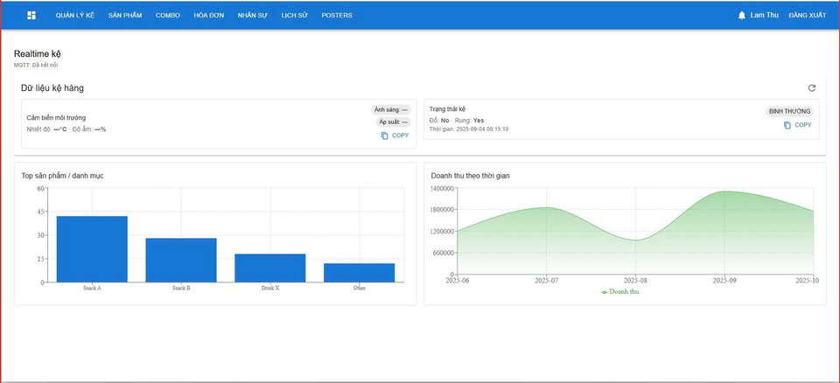
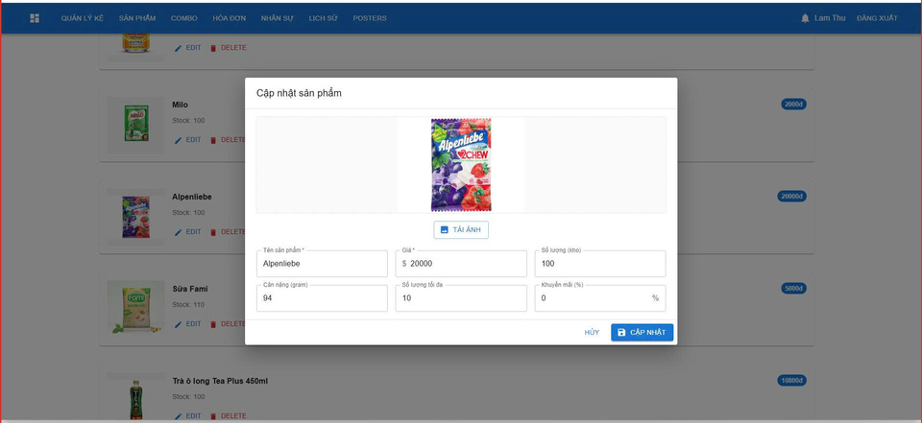
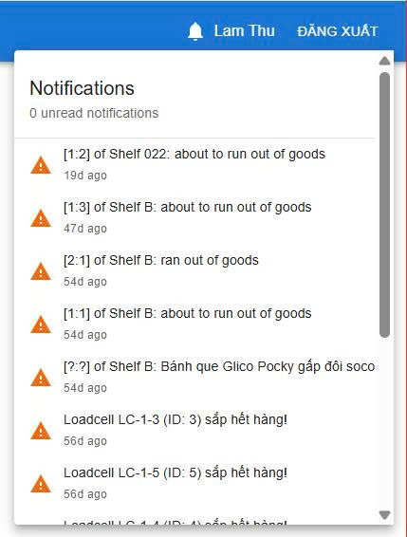
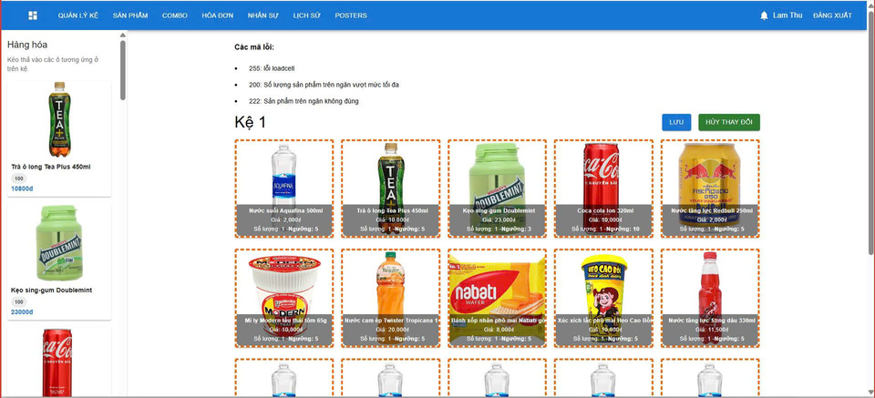
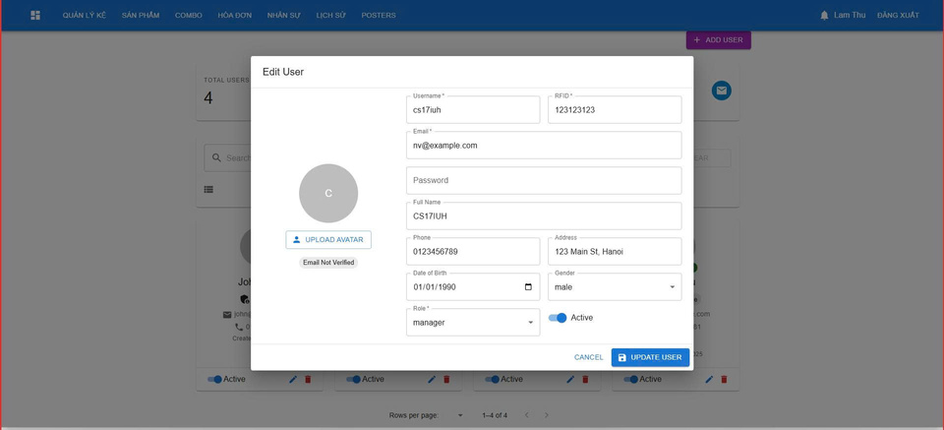
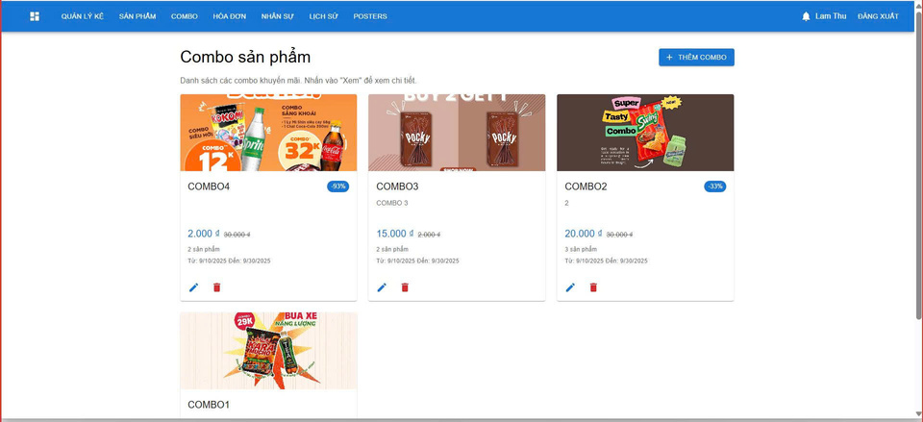
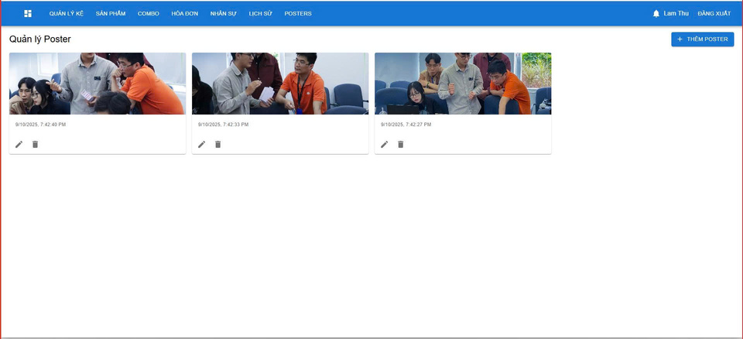
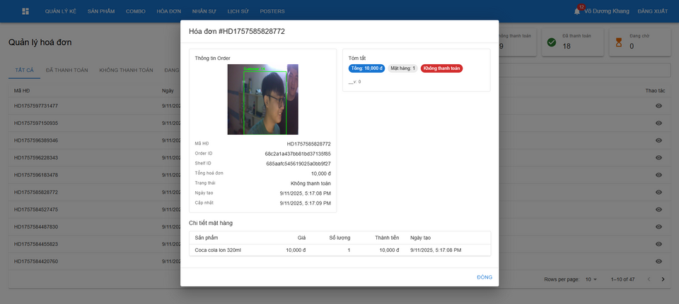
© Copyright FPT Software – Confidential
7
Notes:
7

Slide 13
User flow
Customer walks into an area monitored by a camera
Customer pick up a product from the shelf → Loadcell detects weight change.
BLE Communication Manager sends data to backend.
Backend updates the cart and notifies frontend via WebSocket.
User selects payment button → Backend generates QR code.
Payment gateway verifies transaction and updates order database.
If successful → Receipt generated (optional).
Camera monitors user → If unpaid departure detected, system triggers alarm
Detect presence
Pick item & update cart
Display order summary
Generate QR payment
Payment confirmation & print bill
© Copyright FPT Software – Confidential
6
Notes:
6

Slide 14
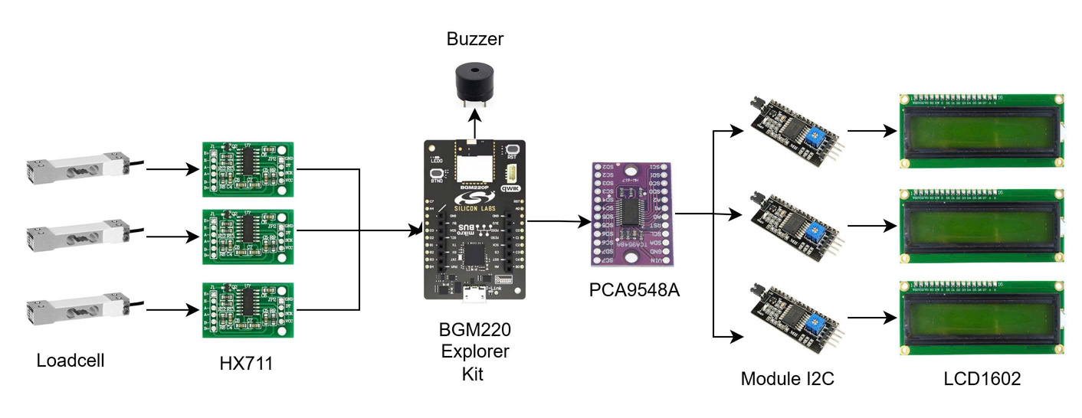
Edge processing
BGM220 receives loadcell signals via HX711 amplifier/decoder. Based on the raw data converted into actual weight, then mapped to the quantity of products.
About the protocol for communicating with other components, when the weight changes, quantity or error status will be transmitted to Jetson nano via BLE.
LCD connected via I2C shows product information.
Loadcell parameters (scale, offset) and product information (standard weight, name, price) are stored in NVM3 for persistence after reboot.
© Copyright FPT Software – Confidential
7
Notes:
7

Slide 15
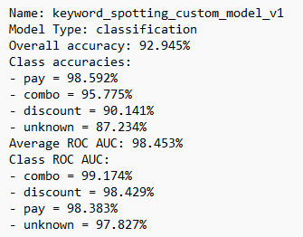
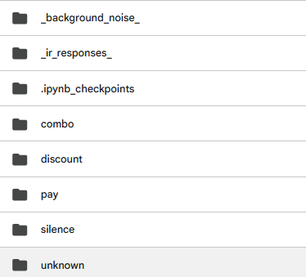

AI on EFR32xG26 Explorer Kit
Using a Convolutional Neural Network (CNN)-based speech recognition model, specifically the TENet12 architecture, trained with MLTK to detect predefined keywords or commands.
The model is trained on Vietnamese audio data, captured directly from the integrated microphone on the EFR32xG26 board, ensuring accuracy and real-world adaptability.
Once the keyword is recognized, the system automatically triggers the corresponding workflow.
Allows customers to complete their purchase without touching any buttons, making the process faster, cleaner, and more user-friendly.
© Copyright FPT Software – Confidential
8
Notes:
Using Convolutional Neural Network (CNN)-based speech recognition model specifically trained to detect predefined keywords or commands.
For example, when a customer says “thanh toán” (which means pay), the CNN model processes the audio signal, extracts acoustic features, and accurately identifies the keyword.
Once the keyword is recognized, the system automatically triggers the payment workflow, such as displaying a QR code on the screen for quick mobile payment.
This hands-free interaction allows customers to complete their purchase without touching any buttons, making the process faster, cleaner, and more user-friendly.
In addition, the CNN-based approach ensures robust performance even in noisy retail environments, increasing the reliability of the system.
8

Slide 16
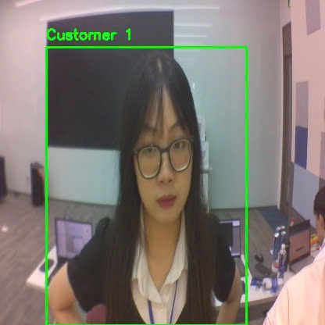
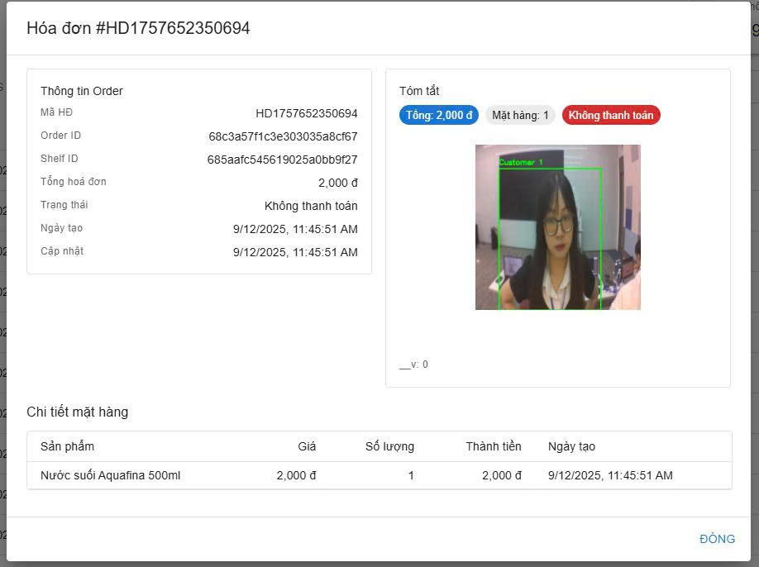
Tracking
Using the YOLO model to detect “person” and passed to the SORT tracker for assigning unique IDs.
Trigger an alert if that “person” is out of the frame without payment and push up to the Web management a receipt with status “payment incomplete”.
If there are 2 different “person” appear in the same frame, it only tracks the “person” that picks up the product.
© Copyright FPT Software – Confidential
7
Notes:
7

Slide 17
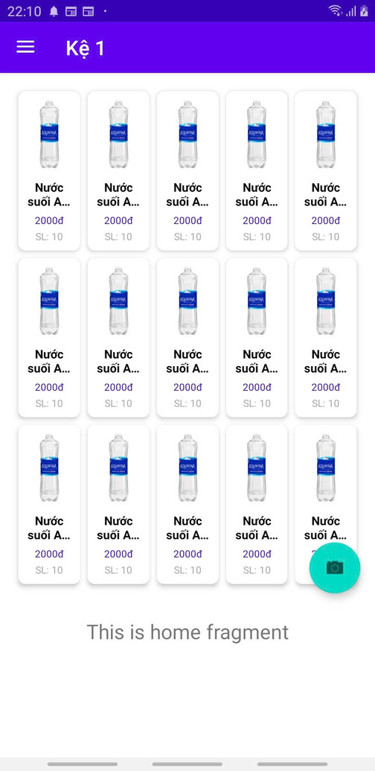
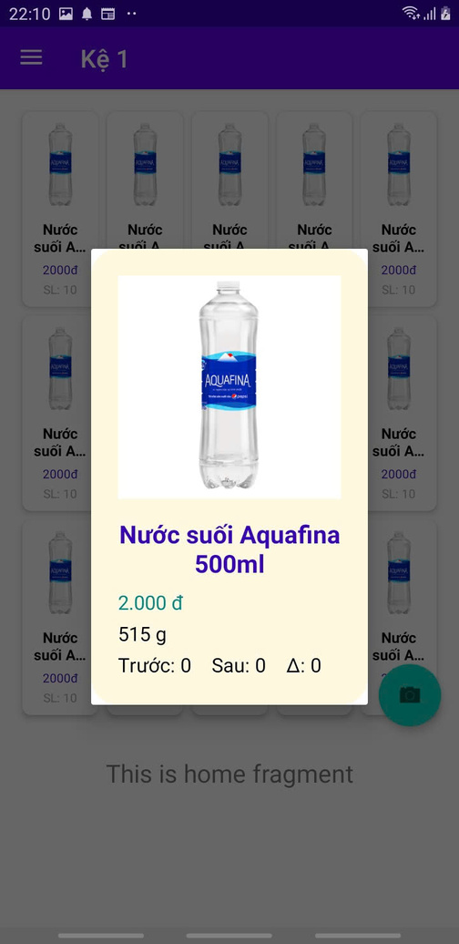
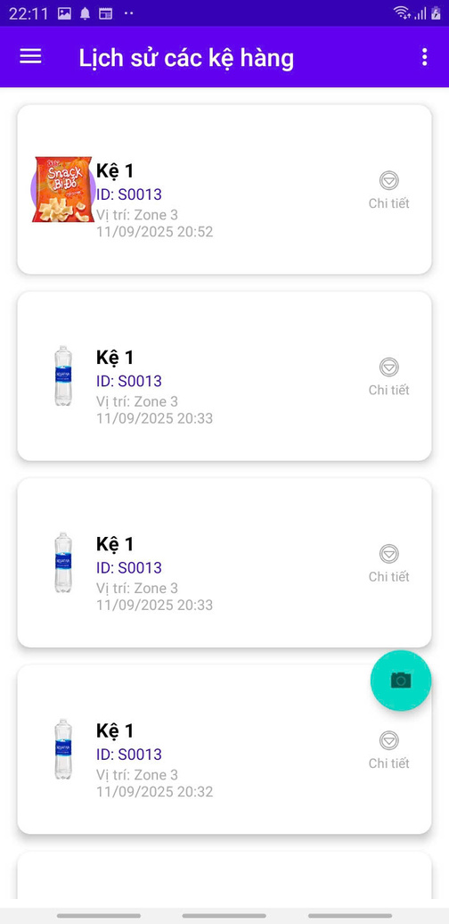
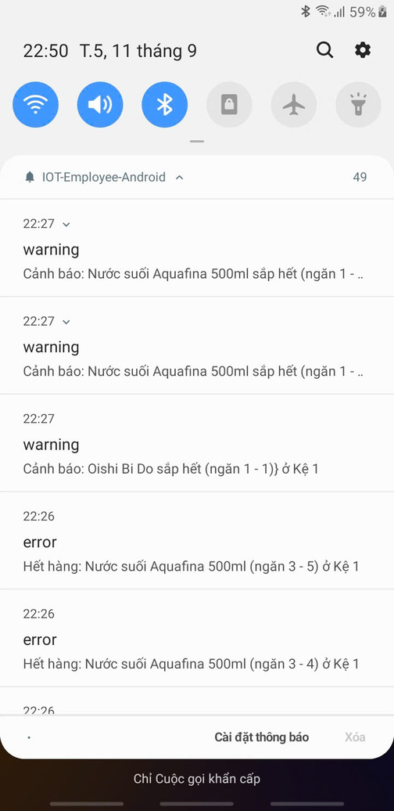
Mobile app
© Copyright FPT Software – Confidential
7
Notes:
7

Slide 18
04
Risk management
© Copyright FPT Software – Confidential
13
Notes:
13

Slide 19
Risk management
Risk | Description | Mitigation Strategy
Incorrect Weight Detection | Loadcell data may be incorrect during the process of customers placing products indecisively. | Use machine learning models to predict customer actions based on loadcell variation data over time
False Positives in Voice recognition | Detections are incorrect occasionally (between different labels under varying environmental conditions) | Apply more data augmentation to increase its diversity, enriching the dataset.
Hardware Failures | Load cells or camera may malfunction. | Implement redundancy or self-diagnostics; notify admin on failure.
Privacy Concerns | Tracking customers with camera may raise issues. | Avoid face recognition; use body shape, anonymized tracking, and comply with local laws.
Misplaced | The customer placed the snack in a position that does not match the actual location. | From the current quantity data of each type of snack compared to its correct quantity, it is possible to detect which snack is placed in the wrong position.
Misplacement of snacks of the same weight | Customers can swap snacks of different prices but the same weight. | The rule for snack shelves is to only sell different snacks that are the same weight if they are priced the same.
© Copyright FPT Software – Confidential
19
Notes:
19

Slide 20

21
Notes:
21

